Slide 1
Vegetation Monitoring at LM Sites
Alexis-Marie Parrish, intern
U.S. Department of Energy
Office of Legacy Management
Grand Junction, Colorado
University of Arizona, NASA Space Grant Symposium
April 20, 2024
Notes:
Introduce name and site

Slide 2



Outline
Introduction
Project Introduction
Methods
Connection to Career
Conclusion

Slide 3
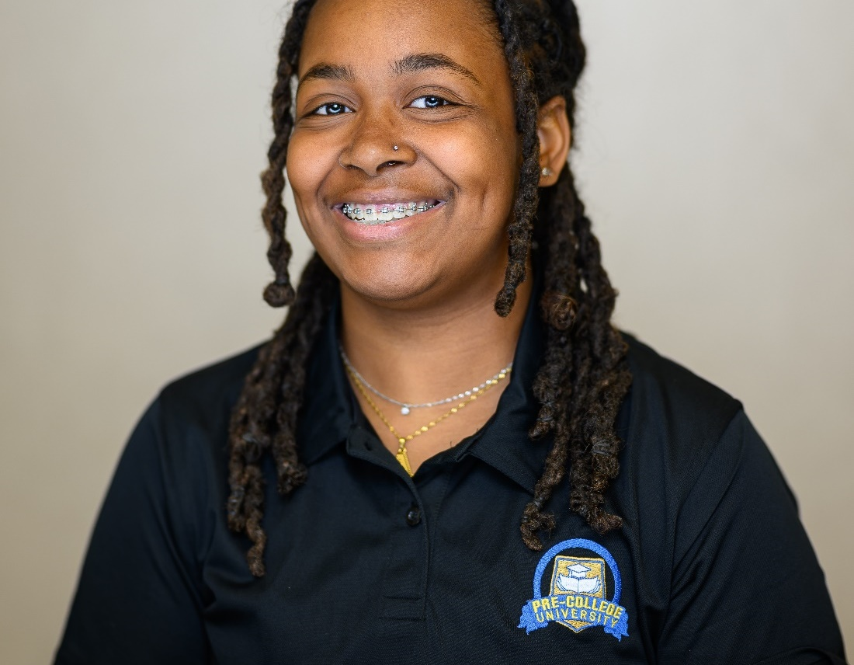
Introduction
Alexis-Marie Parrish
Alabama A&M University
Major: Environmental Science
Concentration: Environmental Management
Career Focus: Organic Clothing

Slide 4
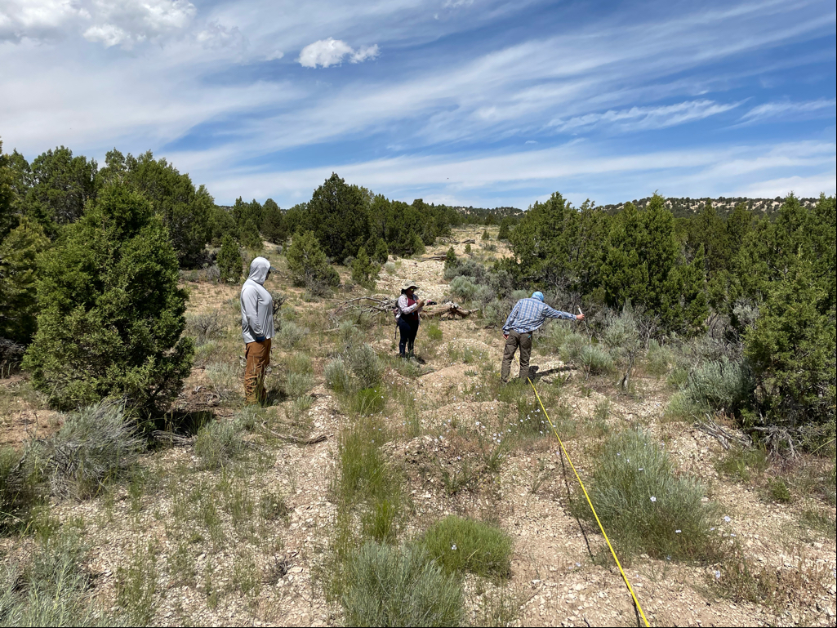
Project Introduction
Worked along David Holbrook, ecologist
Conducted field work and learned vegetation-monitoring methods
Line-Point Intercept
Leaf Area Index
Daubenmire Method
Research question
How can different vegetation- monitoring methods be used in organic clothing production?
Alex McCarty, Alexis-Marie Parrish, and David Holbrook at the Bronco, Colorado, Site
Notes:
Mention that I will go into detail of each method later

Slide 5
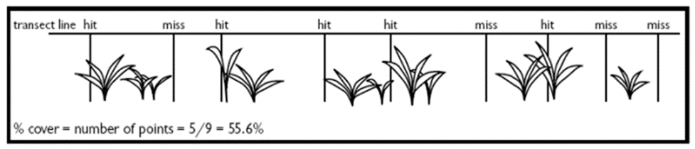
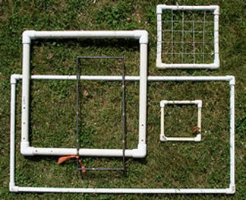
Methods
Line-Point Intercept:
An observation is recorded at every 0.5 meters to help determine site vegetative coverage
Daubenmire Method:
Visual estimated measurements for plant species, amount of bare ground, standing dead, rock, litter, and total foliar cover within a 100 cm by 100 cm quadrant
Data is used to ensure the functionality cover
Line-point Intercept transect line example
Daubenmire quadrant examples

Slide 6
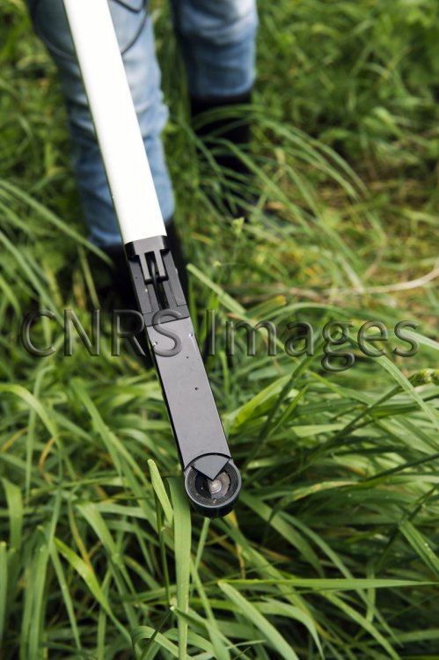
Methods (continued)
Leaf Area Index (LAI):
A hand-held tool used to gather data for crops during the growth process, tracking crop yield and canopy structures over time
Vital information for disposal cell performance and crop production information, including evapotranspiration.
Soil Sampling:
Collecting soil samples in containers for lab testing of physical and chemical properties, including plant growth parameters
LAI Tool example

Slide 7
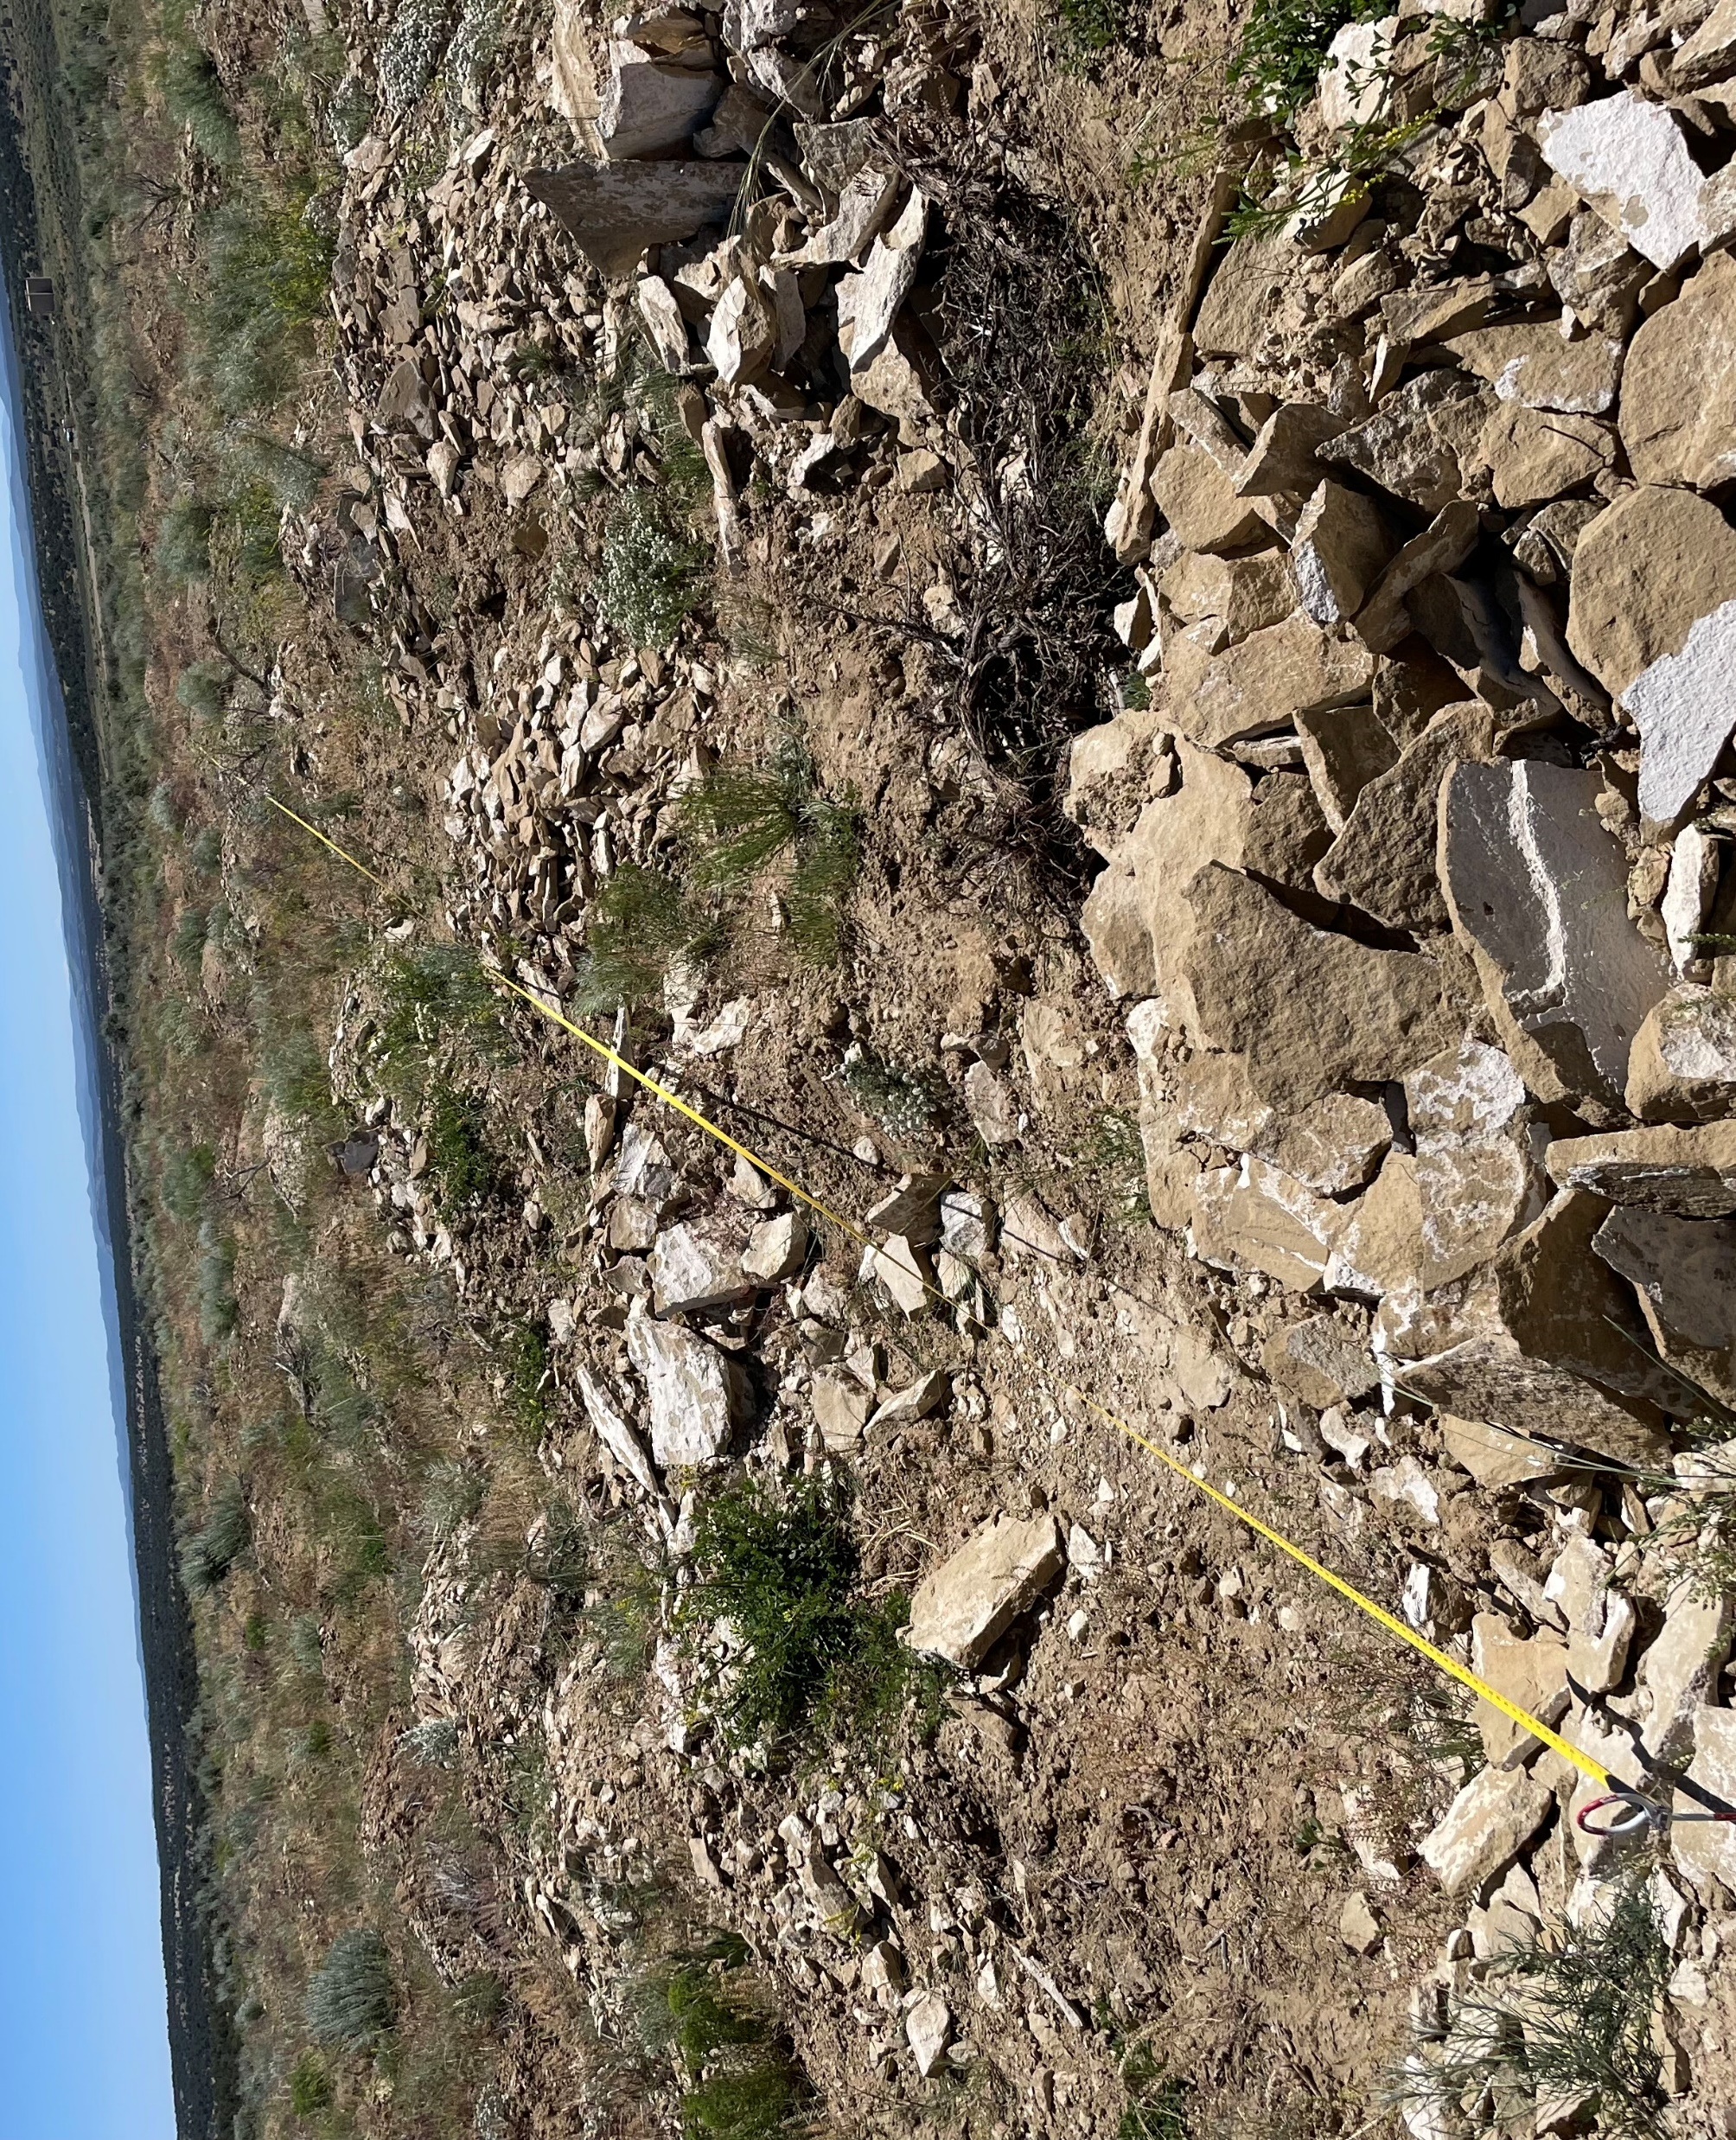
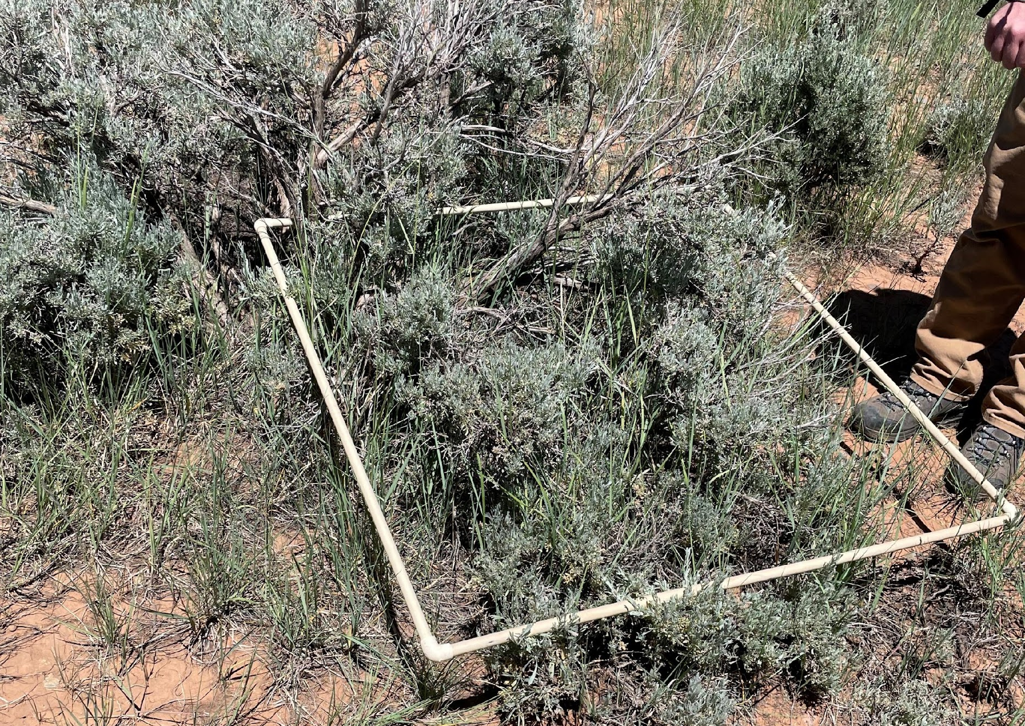
What methods will or will not work?
How is LPI beneficial for cotton plant monitoring?
It can determine the absence or presence of cotton and plant height, density, and growth stage
The Daubenmire method is not ideal
This method monitors natural vegetation by assessing ground coverage percentages, including rock, bare ground, litter, standing dead vegetation, and total vegetation coverage.
LPI at the Bronco site
Daubenmire method at the Monticello Site
Notes:
Daubenmire method is also typically used for crops that do not exceed the height up to your waist

Slide 8
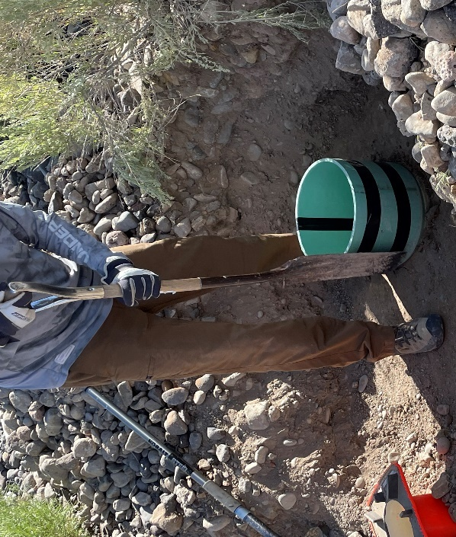
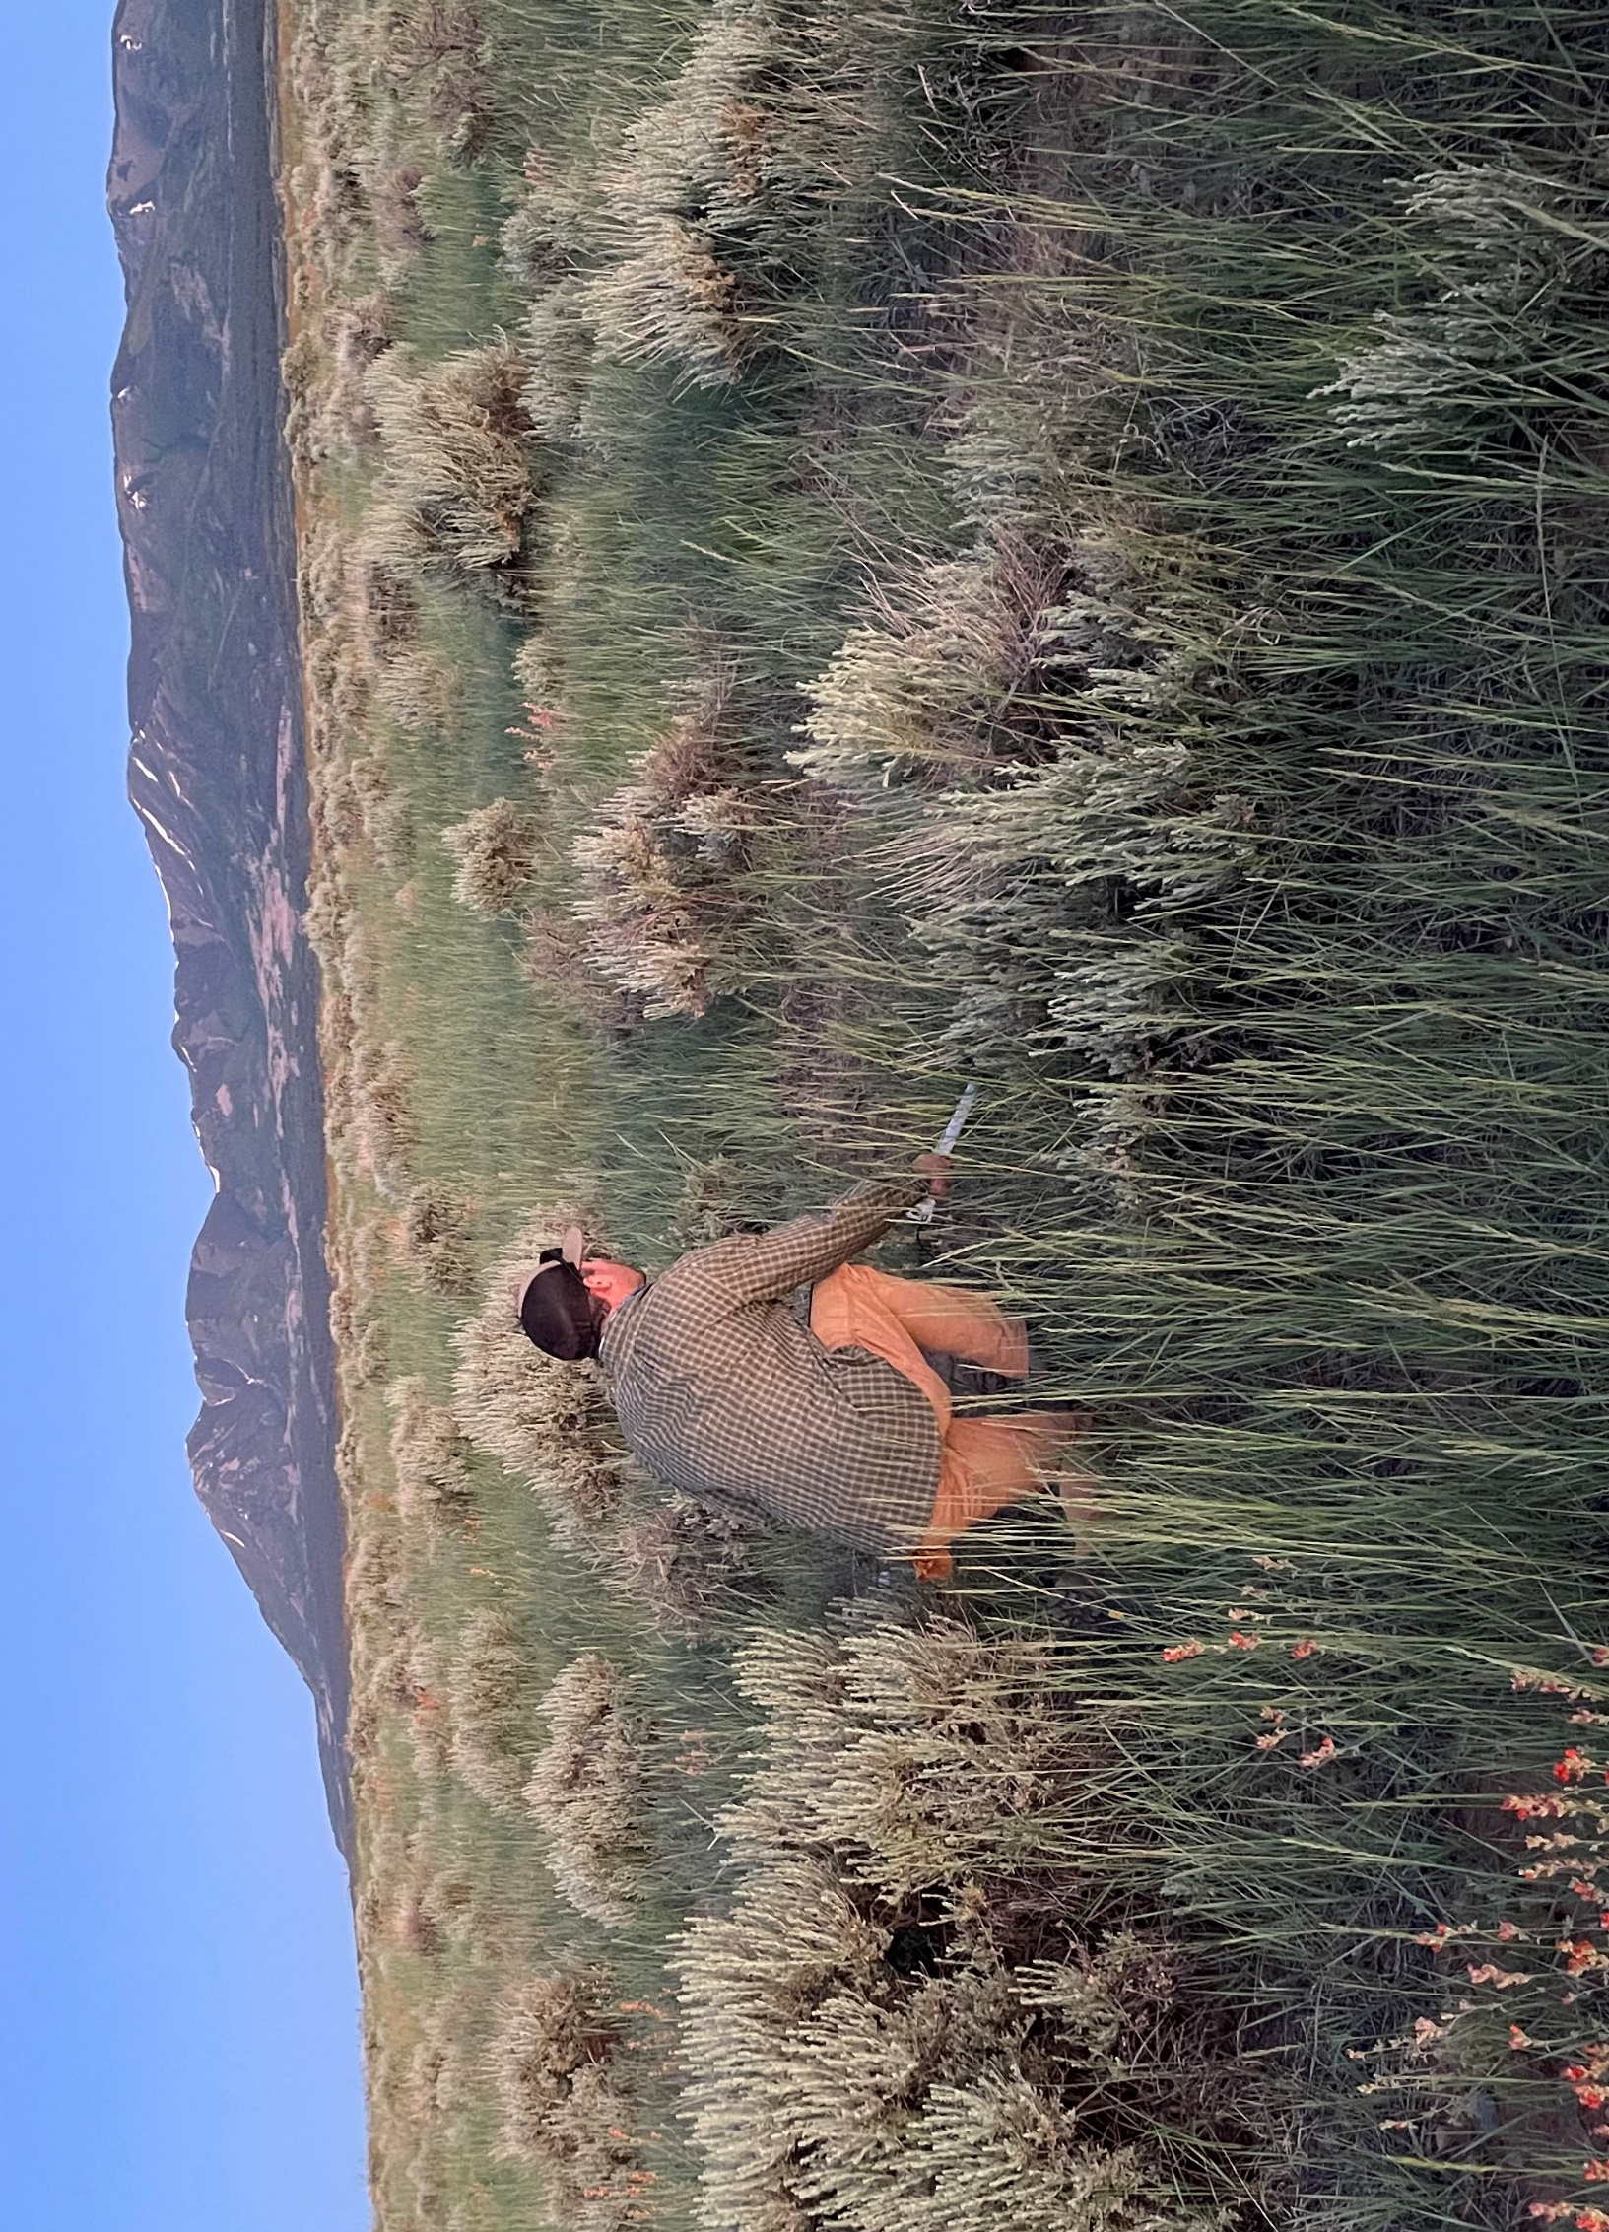
Methods (continued)
Benefits of soil sampling for cotton plant monitoring
This method performs soil analysis to assess fertility, nutrient levels, pH, hydraulic conductivity, and other factors crucial for crop growth. It requires soil with high clay content for water retention.
How can the LAI tool benefit cotton plant monitoring?
It offers insights into crop health, growth, productivity, and precision agriculture, including sustainability, efficiency, and evapotranspiration calculations.
Aaron Tiger starting block sample
Holbrook LAI sampling in Monticello
Notes:
Evapotranspiration for cotton crops:
It is important to know because it can assist with regulating the water needs of the plant to maintain health and growth, therefore it is important to know how much water is needed and when

Slide 9
Now what?
How does this experience relate to my future career?

Slide 10

Future Career: Organic Clothing
How does it connect?
Cotton growth requires plant height monitoring, daily monitoring, and understanding of plant development
Organic Cotton
Grown without the use of GMO seeds and synthetic pest deterrents
Must be grown on land free of prohibited substances for three years
Certified by the USDA
The methods we used vary for cotton monitoring
Reference: Comparing Conventional & Organic Cotton Production. (2020). Cotton Today. Retrieved July 31, 2023, from https://cottontoday.cottoninc.com/wp-content/uploads/2022/07/Cotton-Incorporated-Fact-Sheet-ConventionalOrganic_Final-Approved_06.25.20.pdf
Notes:
Explain that I would like to pursue organic clothing, and how if I investigated cotton particularly for my project
I would like to grow organic cotton and it requires staying away from GMO seeds…

Slide 11
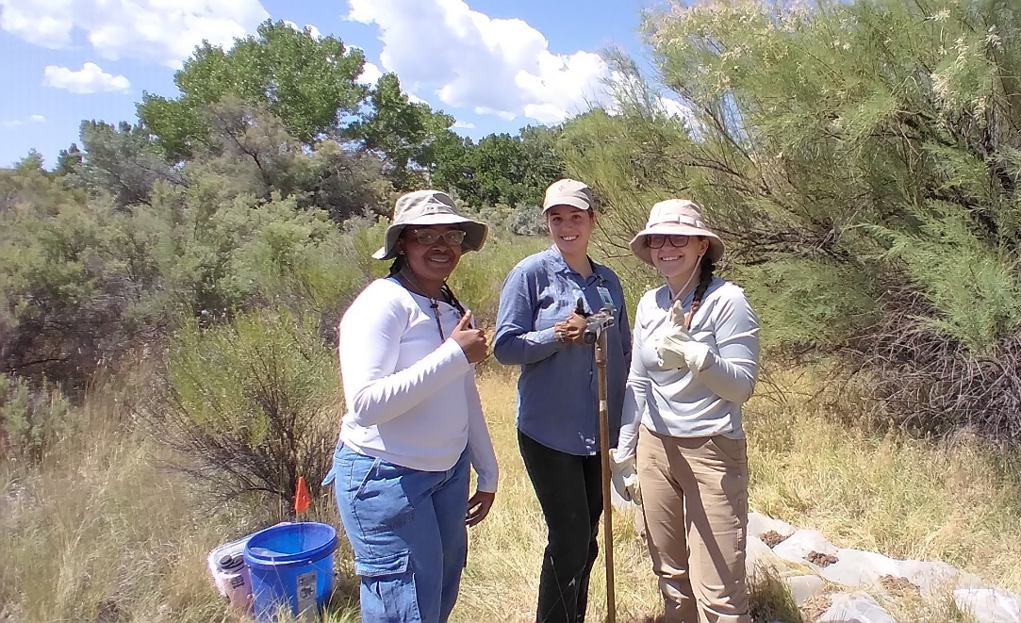
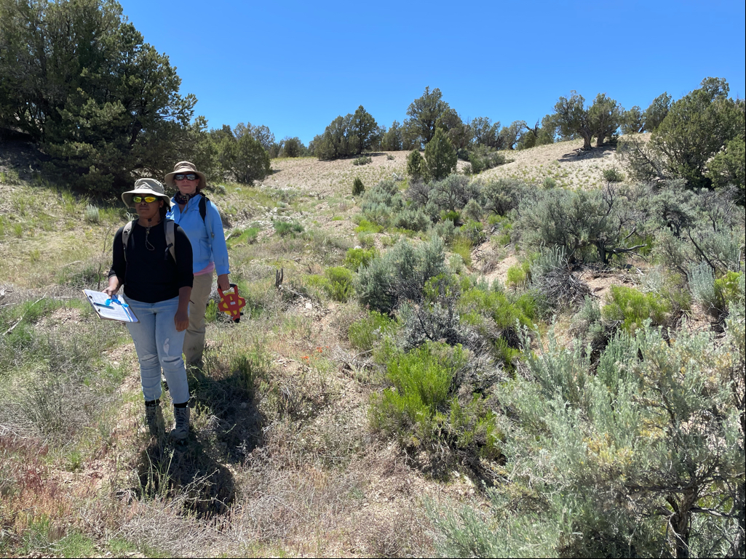
Conclusion
Gained knowledge of DOE disposal cells and the impacts of vegetation on the cells
Gained knowledge of evapotranspiration, hydraulic conductivity, and percolation
Found connections between the vegetation-monitoring methods of a disposal cell and cotton-crop vegetation monitoring
Parrish, Elyssa Baker, and KennaLee Rowley at the LM office at Grand Junction
Parrish and Sonya Daly at the Bronco site

Slide 12

Thank You!
I’d like to acknowledge: Pre-College University (Mentorship for Environmental Scholars), Angelita Denny, David Holbrook, Ray Johnson, Mike Morse, & Mary Young

